Slide 1
Setup a new measuring instance

Slide 2
Bill of Material
Pi 5 with at least 4GB RAM + PSU for pi5
NVME Extension and minimum 128GB SSD
abaton clima measurement system PCB [short: ACMS]
Network Cable RJ45
Digisense
Mux PCB
2 x Scale Duett 8kg
9V PSU
6 x ENS 210
4 x DS18B20 (PT1000)
2 x Hailege MLC90640-D55 IR Cam
Webcam with USB
2 x flow sensor Digiten FL-308T

Slide 3
Setting up the new pi
take a new pi and generate an image for a pi5 with some settings:
username: rabaton
password: lack..
wifi: rudi // bbaton125!
enable ssh
first time boot use an external monitor and obtain the IP address of the device
enable under preferences -> raspberry configuration
onewire
I2C
SPI
then reboot. afterwards -> Accessoires -> SD Card Copier
copy content of SD card onto SSD (new UUID Partitions must be checked)
open sudo nano /boot/firmware/config.txt and add the lines:
dtparam=pciex1
dtoverlay=w1.gpio -> dtoverlay=w1.gpio,gpiopin=26
apt install fswebcam
power off, remove SD card, power on
register the pi with our raspberry cloud:
sudo apt update
sudo apt upgrade
click icon right top on the desktop with the two squares and the circles and use
beschaffung@abaton.studio
rasART135!
ssh key für ds_readout git raphael geben
ssh-keygen -t rsa
den public key ins gitHub kopieren als deploy key
git clone https://github.com/xtlc/ds_readout.git machen am pi
cd ds_readout
python -m venv venv
source venv/bin/activate
python -m pip install -r req
Create an empty env file nano .env, save with CRTL + O and [y]
echo 'export GIT_MERGE_AUTOEDIT=no' >> $HOME/.bash_profile && . $HOME/.bash_profile #make sure the git pull does not open an editor

Slide 4
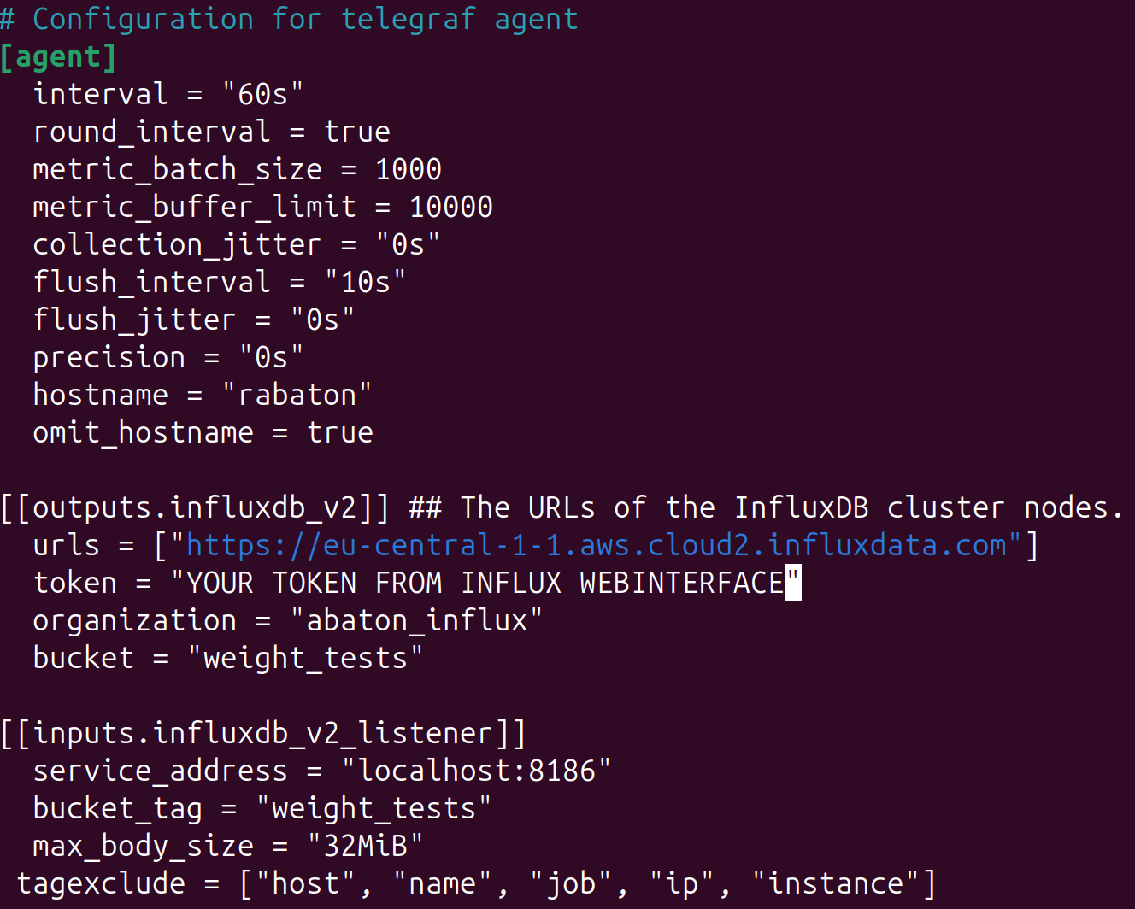
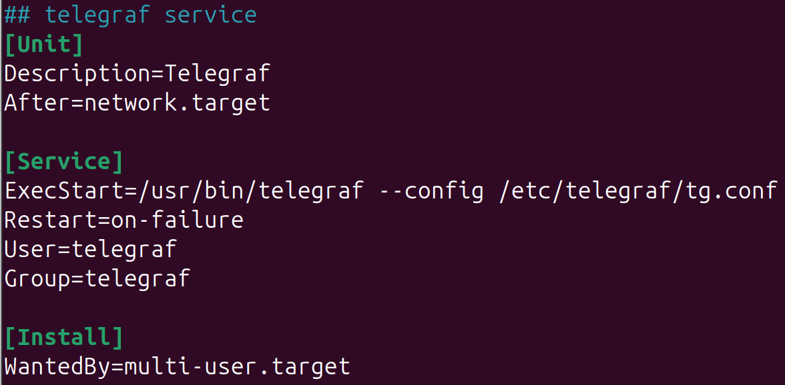
Setting up telegraf
Telegraf is a service that makes sure, when data should be stored at influx but the internet connection is disrupted, that the data is stored locally and sent once internet is available again.
Install guide: Link and quick start: Link
SSH into the raspberry or access locally:
wget -q https://repos.influxdata.com/influxdata-archive_compat.key
echo '393e8779c89ac8d958f81f942f9ad7fb82a25e133faddaf92e15b16e6ac9ce4c influxdata-archive_compat.key' | sha256sum -c cat influxdata-archive_compat.key | gpg --dearmor | sudo tee /etc/apt/trusted.gpg.d/influxdata-archive_compat.gpg > /dev/null
echo 'deb [signed-by=/etc/apt/trusted.gpg.d/influxdata-archive_compat.gpg] https://repos.influxdata.com/debian stable main' | sudo tee /etc/apt/sources.list.d/influxdata.list
sudo apt-get update && sudo apt-get install telegraf
sudo nano /etc/telegraf/tg.conf (be sure to input influx token)
Start telegraf with raspberry (re)boot
sudo nano /etc/systemd/system/telegraf.service -> copy config from telegraf service file
sudo systemctl daemon-reload (you need to execute this if you made a typo somewhere in the confs to reload them)
sudo systemctl start telegraf
Check if it really runs: sudo journalctl –u telegraf.service
Reboot and check if it is running: sudo journalctl –u telegraf.service

Slide 5
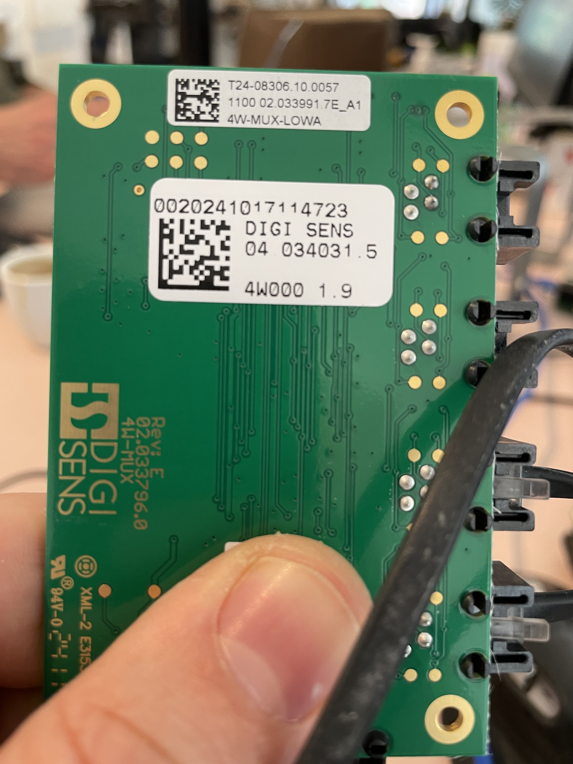
Setting up the scales
Connect MUX to ACMS using a RJ45 cable
Plug 9V power supply into ACMS
Take Sticker from MUX plate and use number
write number into the .env file:
MUX=0020241017114723 (in this case)
Connect the left scale to port 1 of the mux
Connect the right scale to port 2 of the mux
Test the scales with activated venv:
python scales.py -> you should see something like: 1.903successful, revision of the mux: #21gr002024101711472334

Slide 6
Installing the mlx90640 IR cam
Cut power to ACMS board and pi before proceeding!
Connect SDA, SCL, VCC, GND as written on the cam and ACMS
Test the module using the ir.py:
python ircam.py -> should create 2 images in the „rclone“ folder

Slide 7
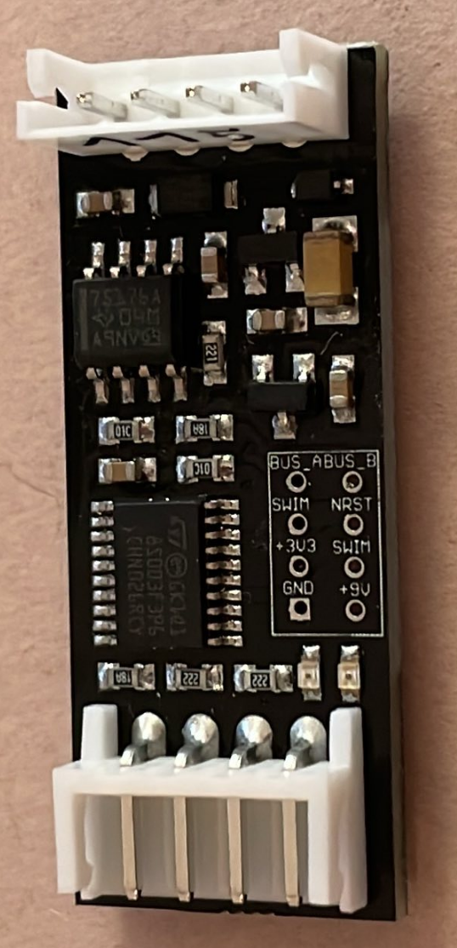
Setting up the ENS210 temperature & humidity sensors
to ACMS
number
Take 6 sensors (preferably in ascending order) plus head
Sensor number is written on the plug that is standing (turn around to be sure which side connects to the ACMS)
Transform the number from decimal to ASCII (see last img)
Connect a cable to the head and one to the ASCM
Cables to sensor head need to be crossed out!
to sensor head

Slide 8
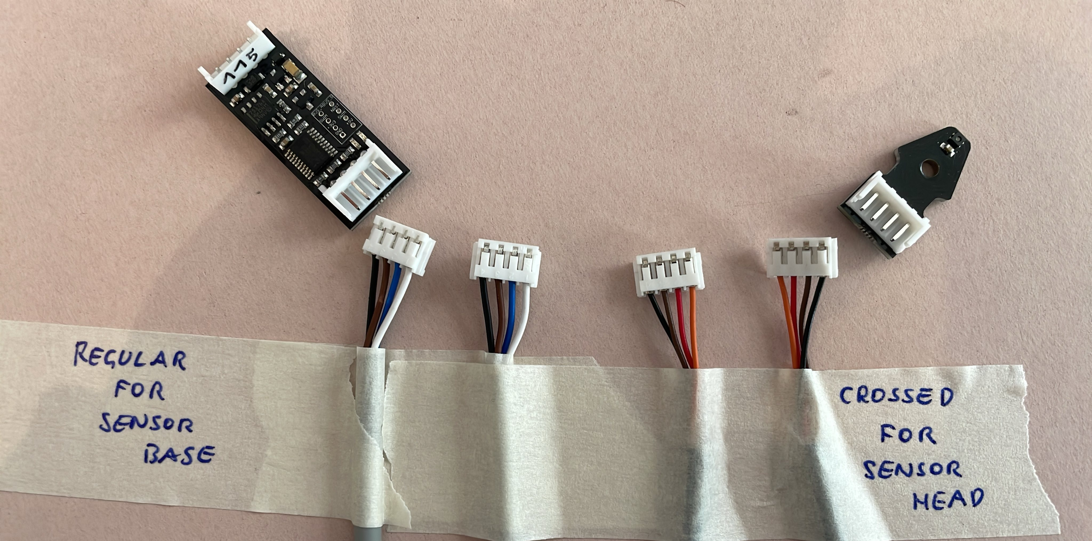
ENS210 Cables
Two cables with identical plugs exist for the ENS210, but they need not to be mixed (see black GND cable for example)
Cable lengths needed
2 x 110 cm top le/ri
2 x 130 cm bot le/ri
1 x 70 cm top mid
1 x 80 cm bot mid

Slide 9
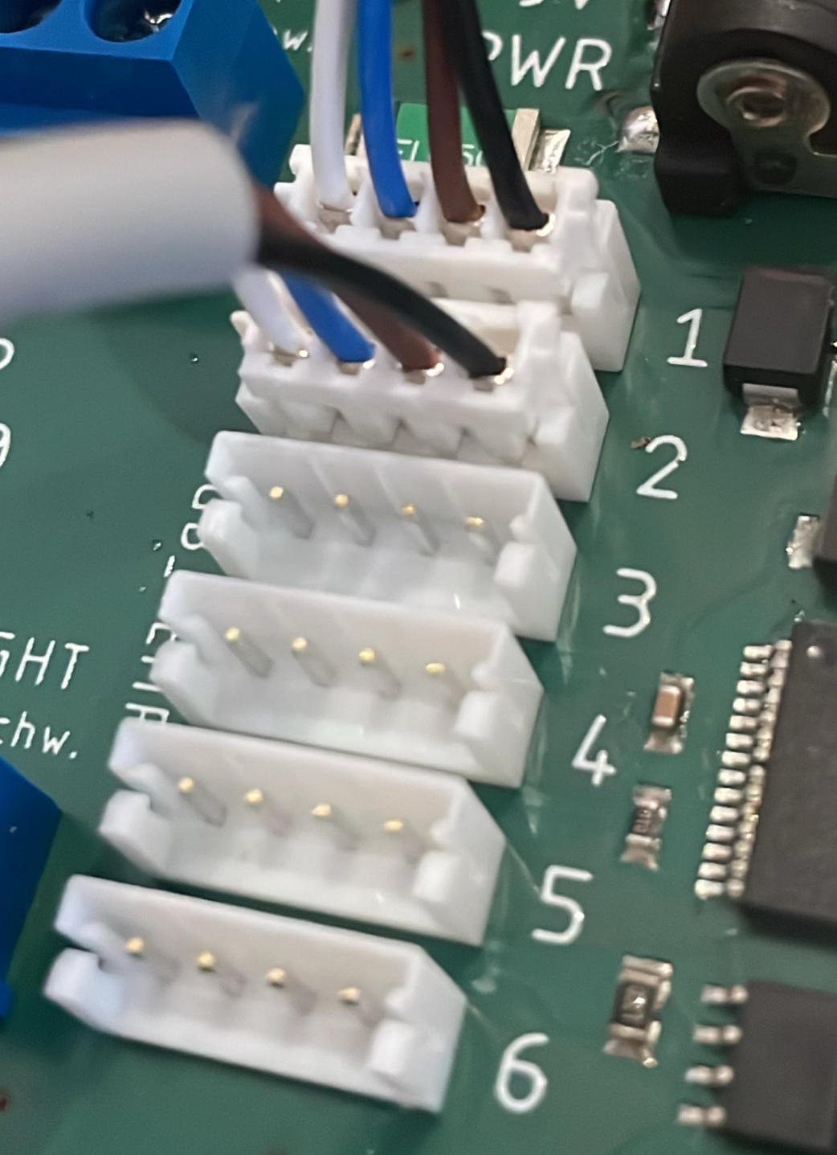
Setting up ENS210 part 2
Arrange the ENS210 in ascending order.
103 would go to #1
104 would go to #2
...
nano .env
Put in the according letter „g“ or „d“
103
104
105

Slide 10
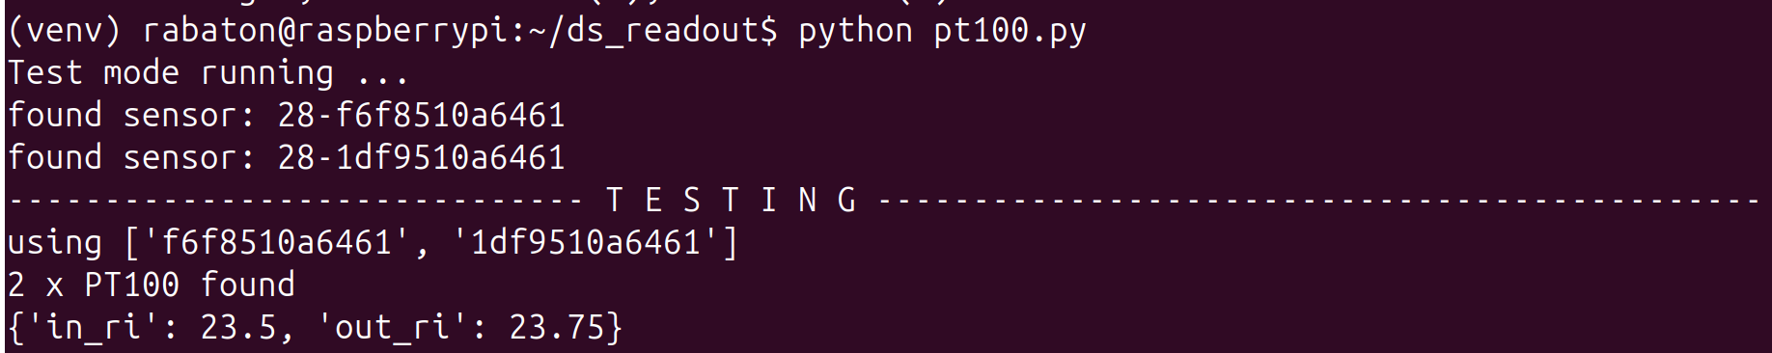
Setting up the pt100(s)
Connect ONE pt100 to the board according to where it is located – lets say you start with OUT_RIGHT
Run python pt100.py in the activated venv, you should see a hexadecimal string proceeded by 28- ...
Write down the string as „OUT RIGHT“ and connect a second pt100 on OUT LEFT -> re-run pt100.py and write down the new sensor
Proceed until you have all 4 sensors and their placement.
For 2 sensors it would for example look like this (touch for 10 secs to see temp change)
Put the values of the 4 sensors into the .env file:
nano .env

Slide 11
Setting up the flow sensor
Carefully check the cable colors, as they may change when usigin
Standard pins for the ACMS should be 12 and 13 (see code)

